Slide 1
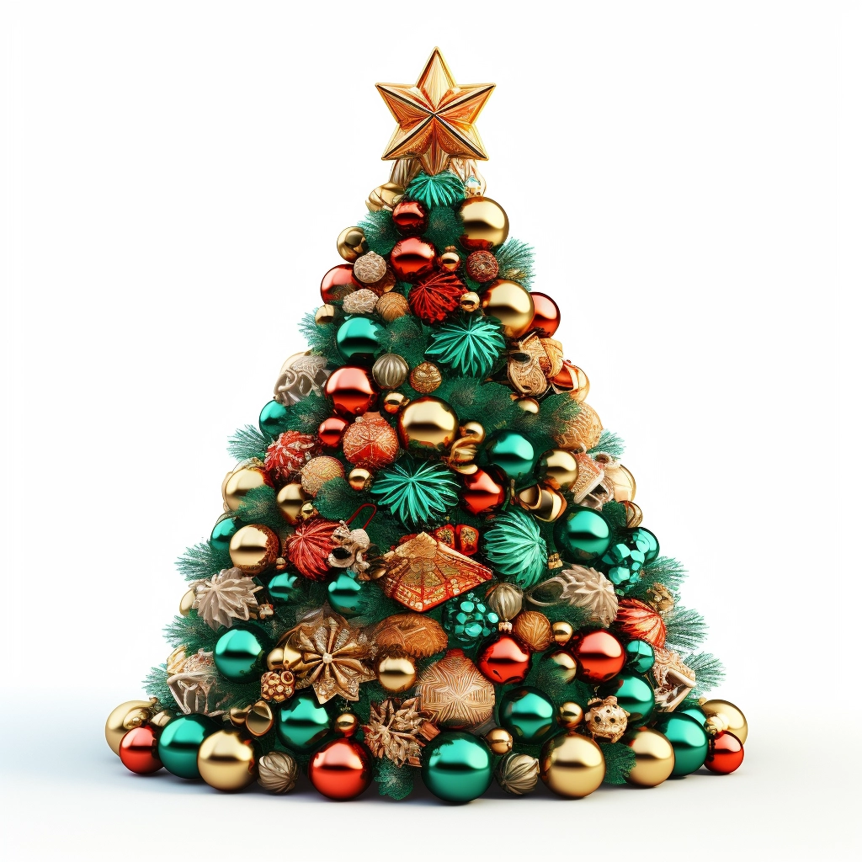

Do you understand where your models live?
HIGH DIMENSIONS
Paul Dubois - MICS Christmas day 2023
Notes:
Paper + token intro
=> things impossible in low dimensions may become possible in higher dimension

Slide 2
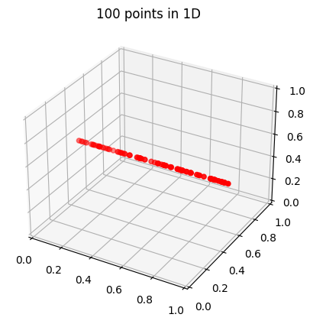
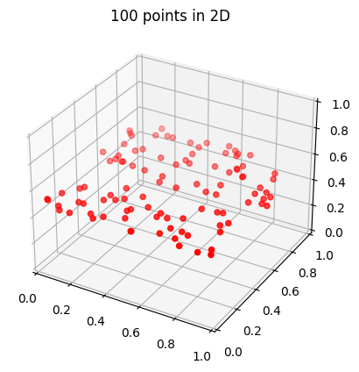
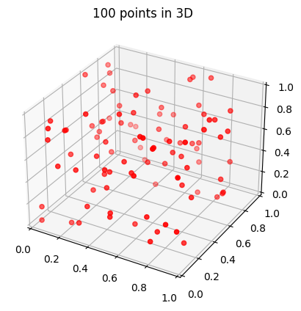
Curse of dimensionality
Notes:
For high dimensional pbs, we need A LOT of data

Slide 3
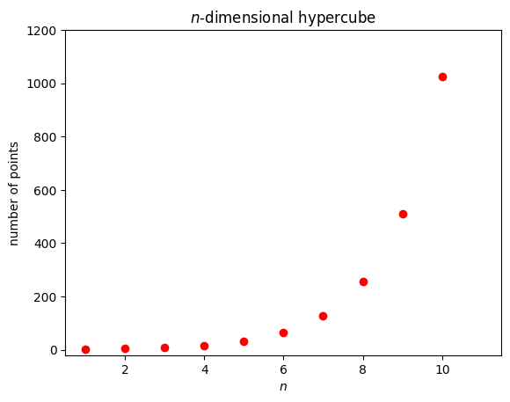
Curse of dimensionality
Notes:
Please don’t do grid search in high dimension

Slide 4
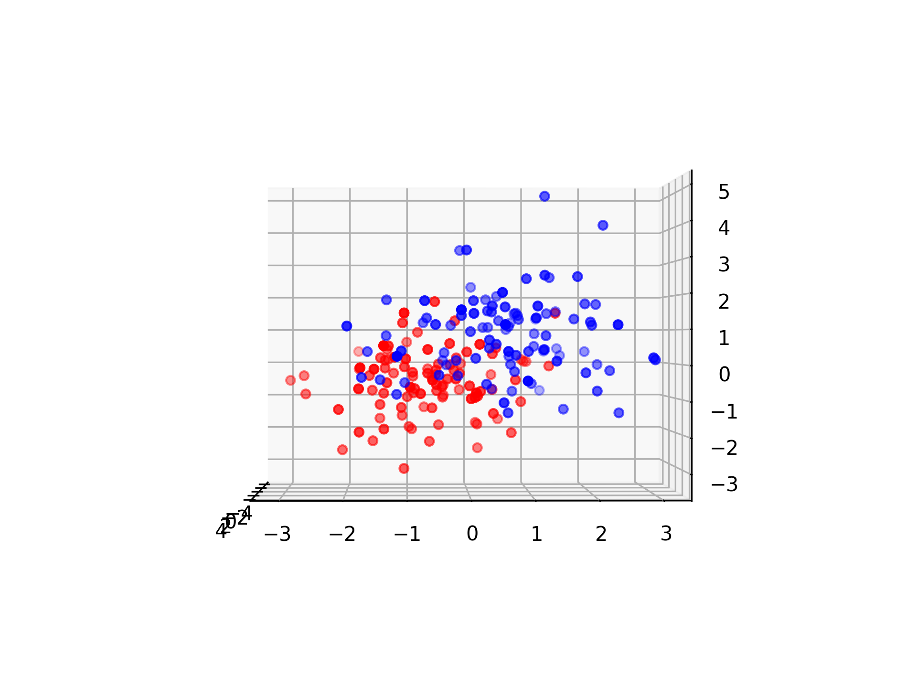
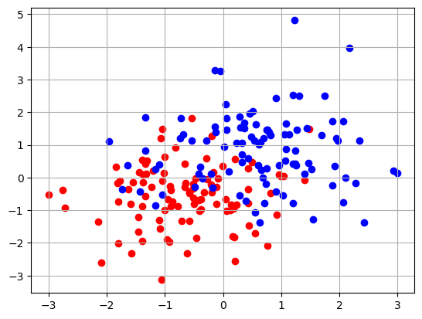
Blessing of dimensionality
Notes:
Seems hard to separate the two classes in 2D…

Slide 5
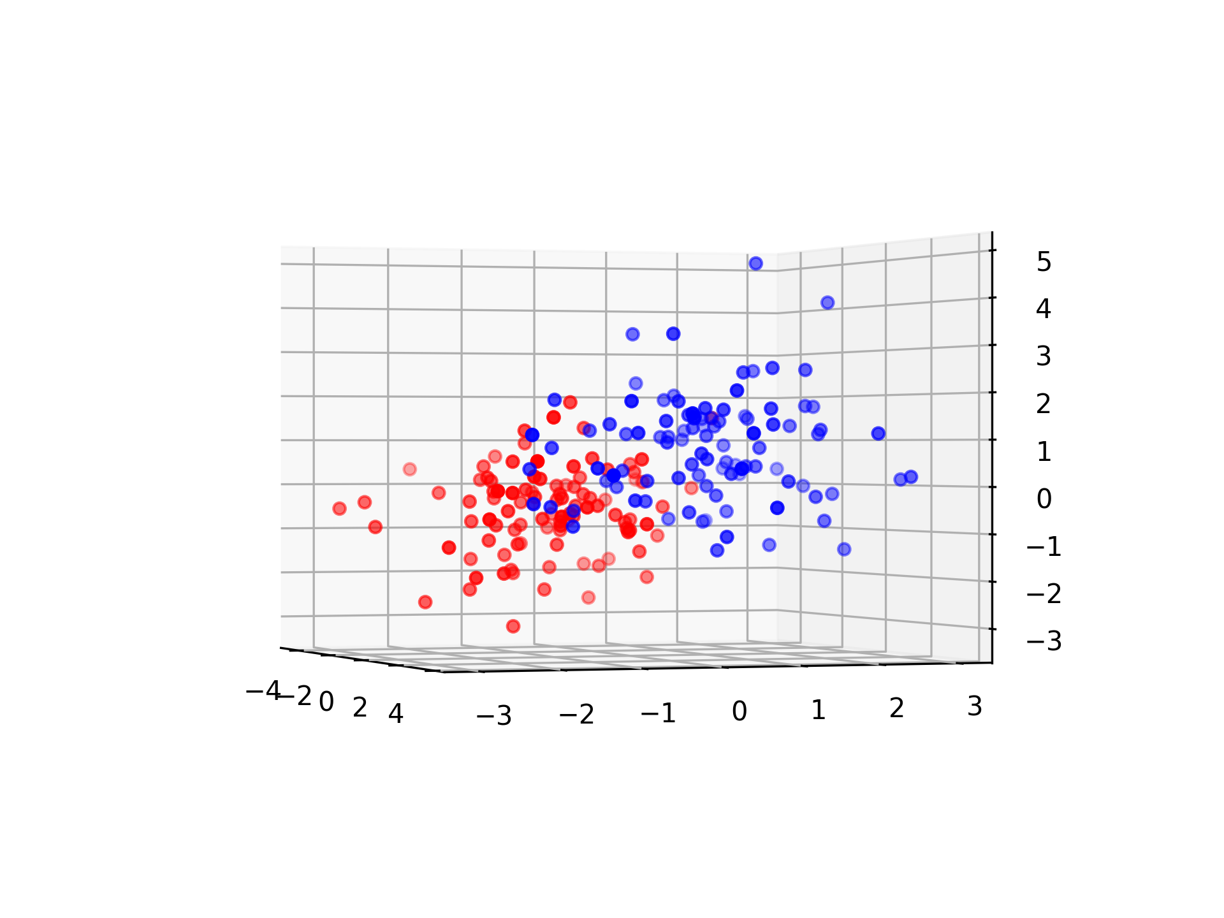
Blessing of dimensionality

Slide 6
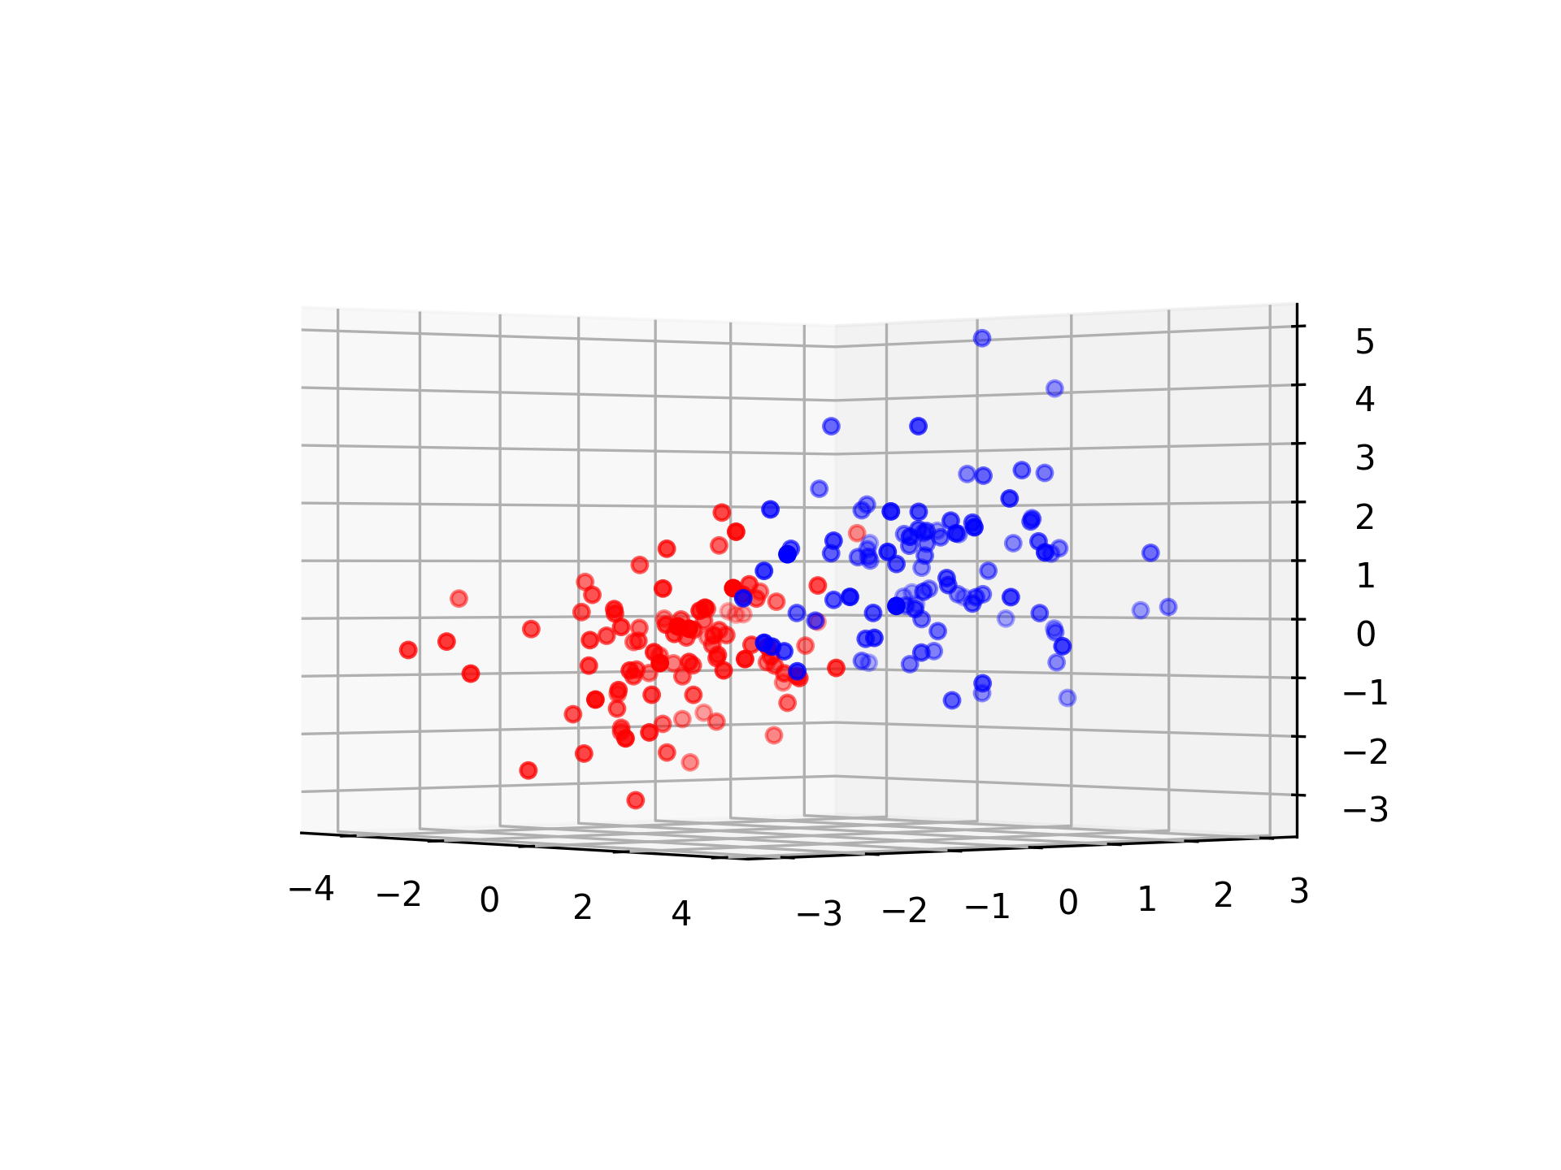
Blessing of dimensionality

Slide 7
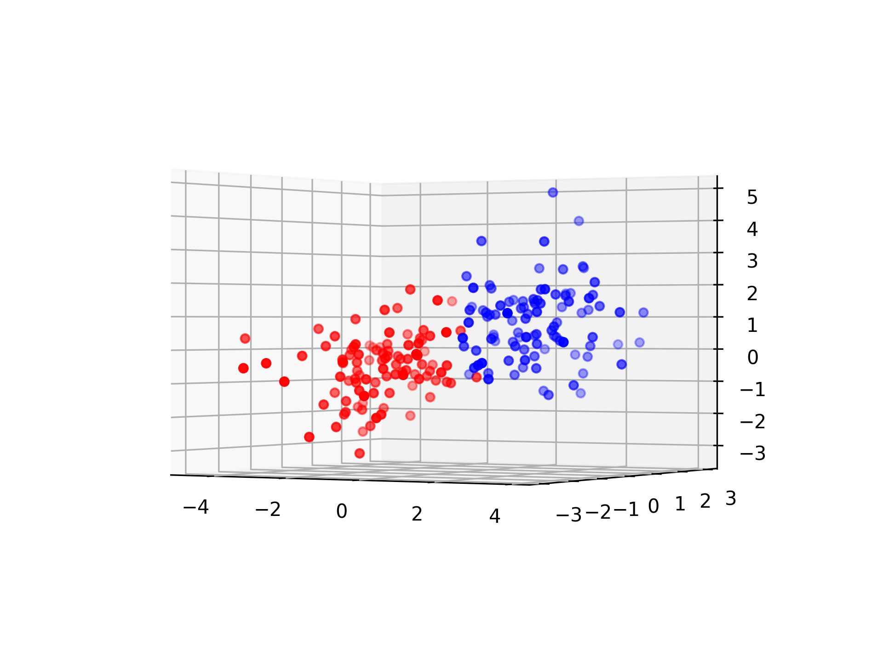
Blessing of dimensionality
Notes:
But the 3rd dimension might help!
=> higher dimensional model might allow more simple models

Slide 8
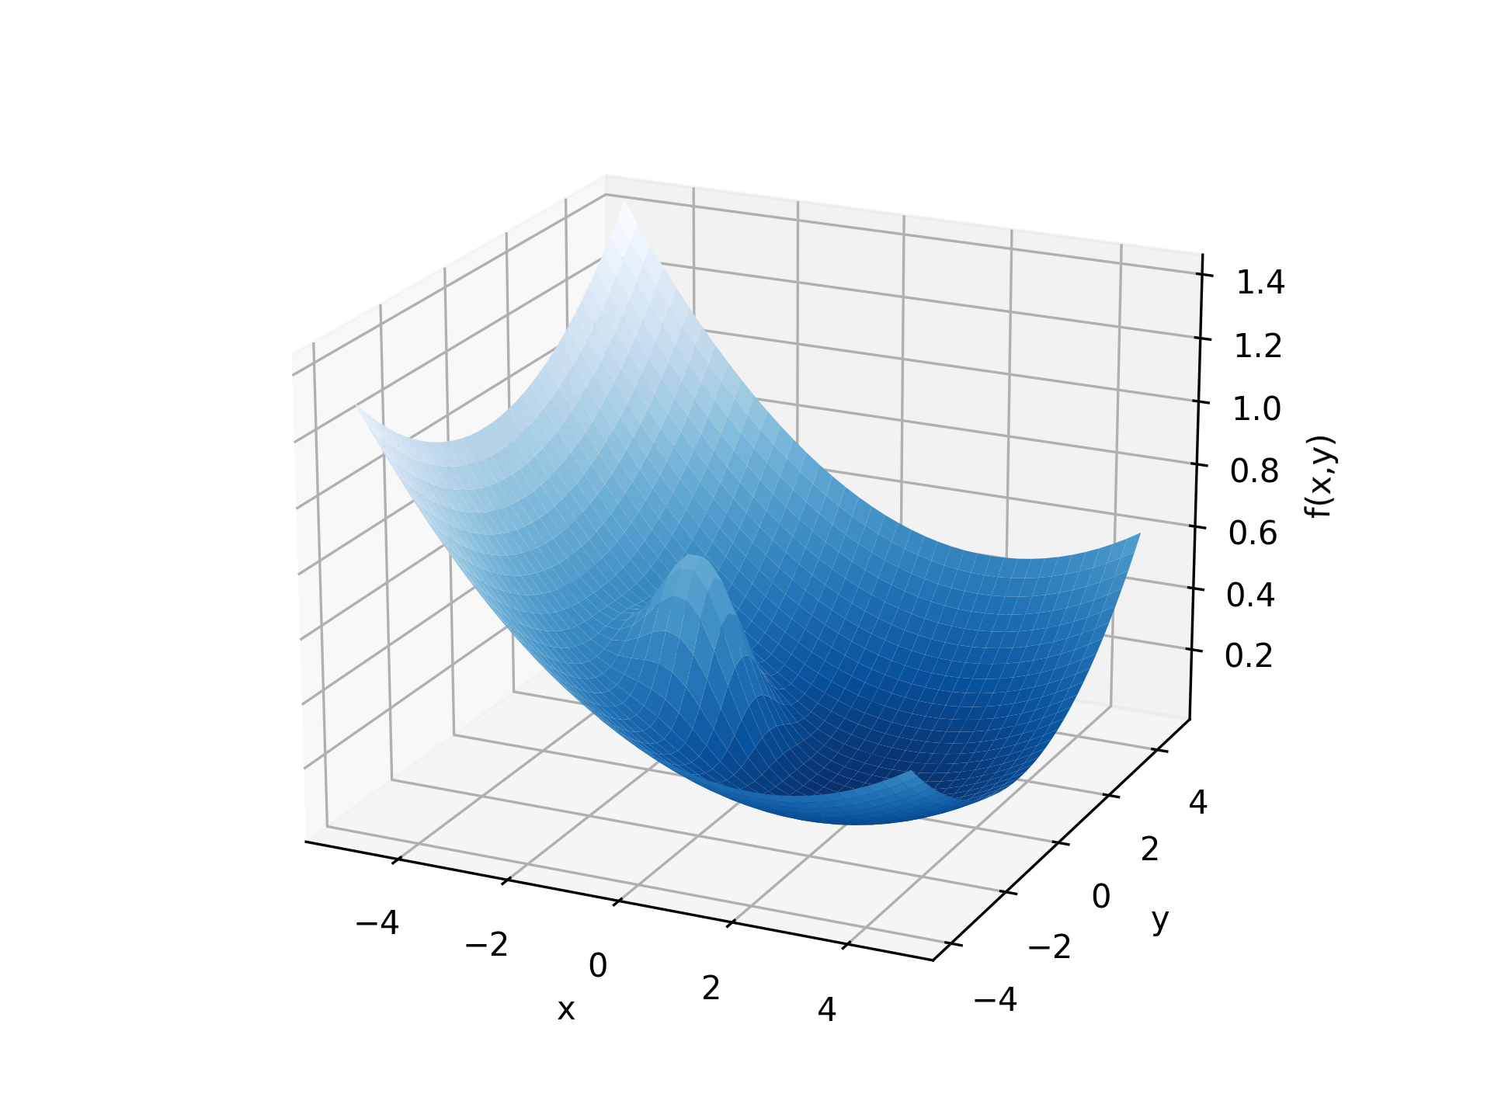
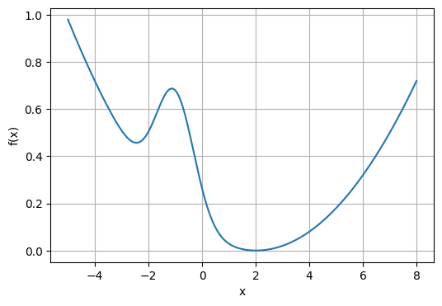
Blessing of dimensionality
Notes:
With gradient descent on the 1D function, we can get stuck in a local minimum
But the 2nd dimension may help!
=> Gradient descent is suitable for high dimensional models
The idea is that “there is (almost) always a direction that is not stuck”

Slide 9

Blessing of dimensionality

Slide 10

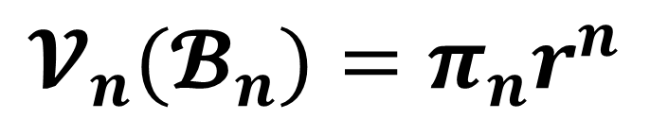
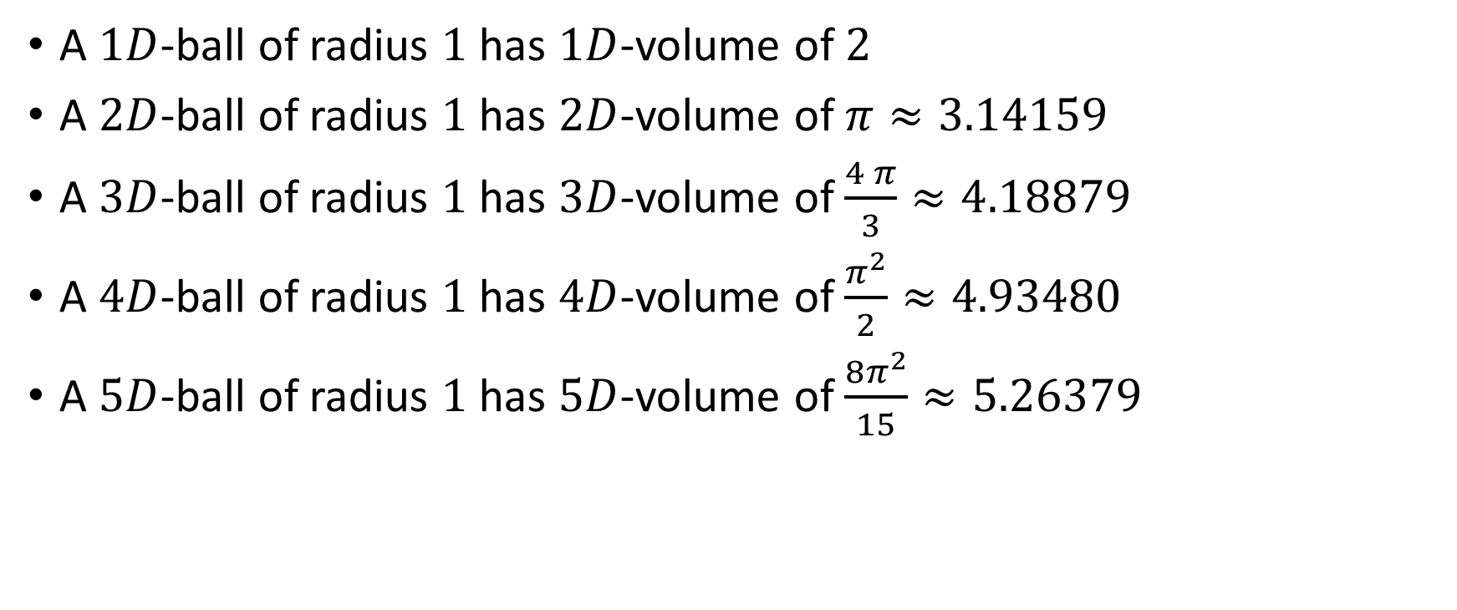
Higher dimensions of $π$
$$𝓥_{n}(𝓑_{n})=π_{n}r^{n}$$
(length)
(area)
A $1D$-ball of radius $1$ has $1D$-volume of $2$
A $2D$-ball of radius $1$ has $2D$-volume of $π≈3.14159$
A $3D$-ball of radius $1$ has $3D$-volume of $\frac{4 π}{3}≈4.18879$
A $4D$-ball of radius $1$ has $4D$-volume of $\frac{π^{2}}{2}≈4.93480$
A $5D$-ball of radius $1$ has $5D$-volume of $\frac{8π^{2}}{15}≈5.26379$
Notes:
Make audience guess for 3D, 4D (and 5D?)

Slide 11
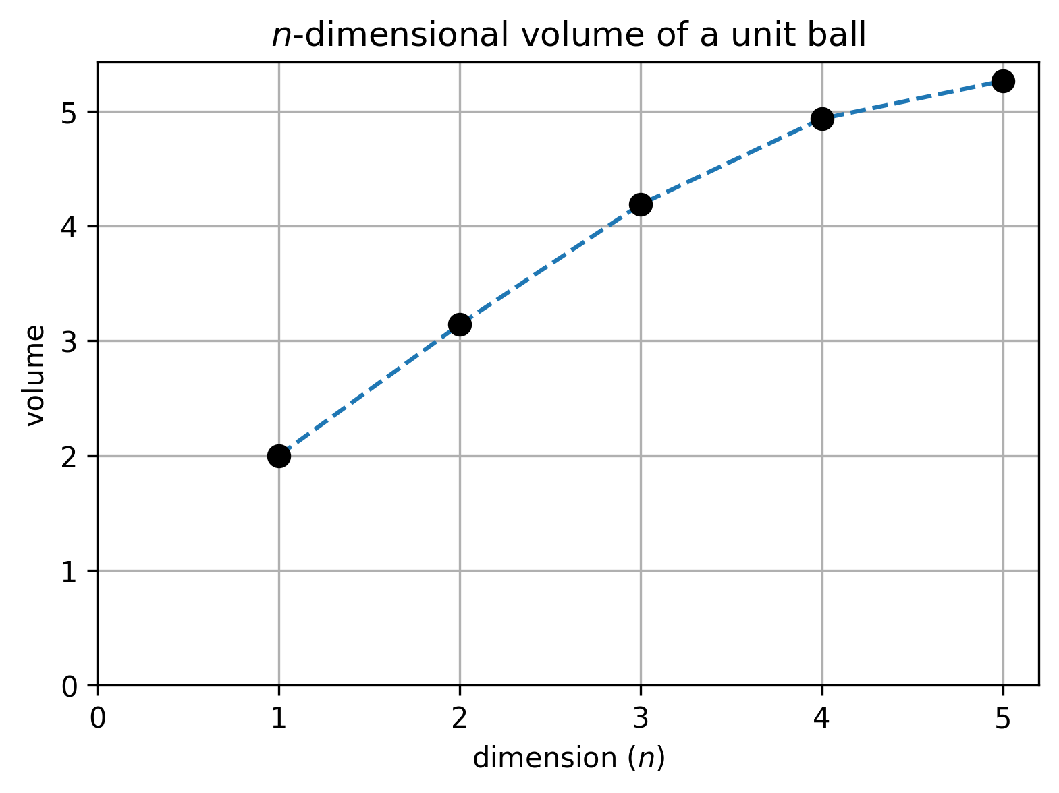
Higher dimensions of $π$
Notes:
“it makes sense that in higher dimensions, unknit balls have a larger volume”

Slide 12
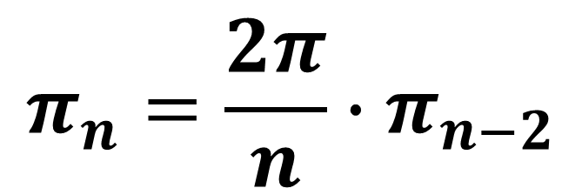
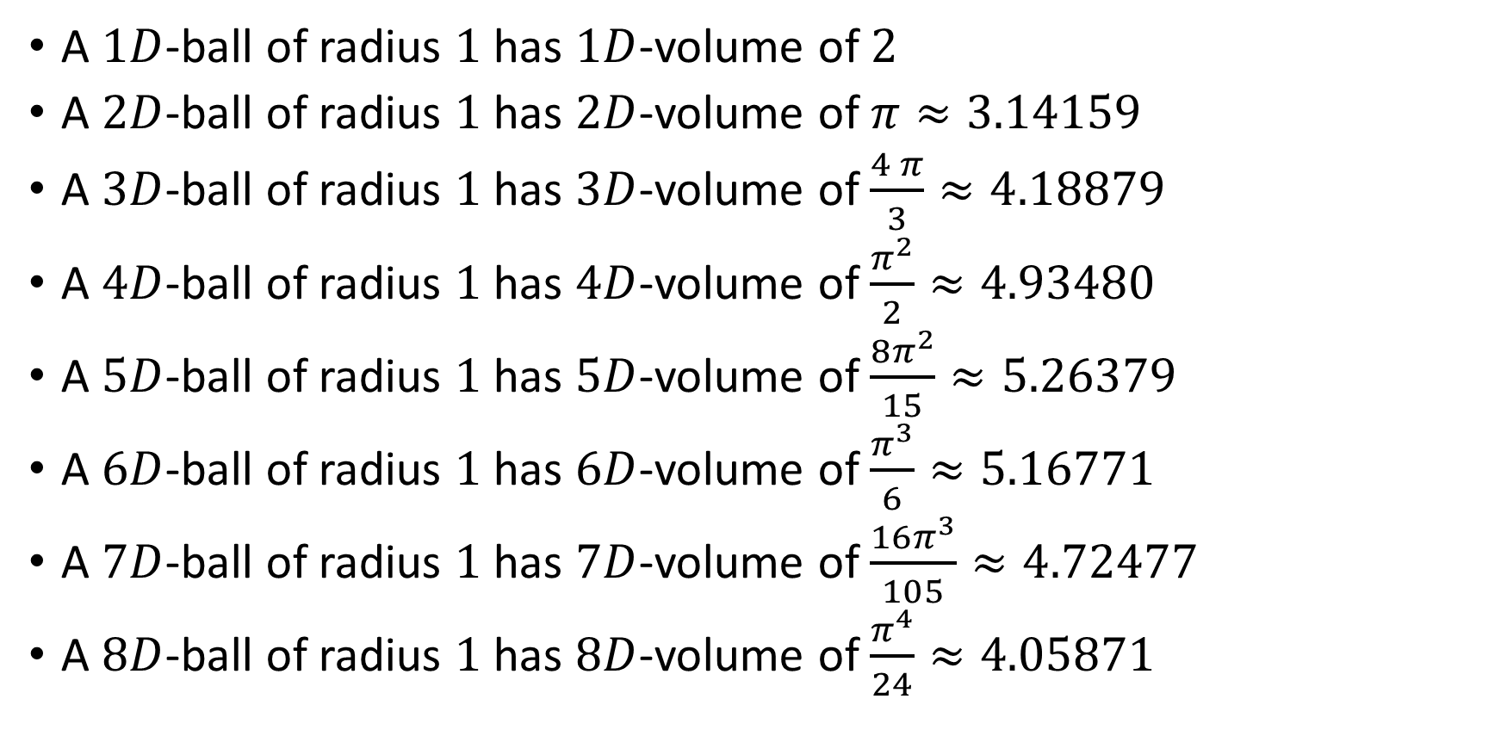
Higher dimensions of $π$
$$π_{n}=\frac{2π}{n}∙π_{n−2}$$
A $1D$-ball of radius $1$ has $1D$-volume of $2$
A $2D$-ball of radius $1$ has $2D$-volume of $π≈3.14159$
A $3D$-ball of radius $1$ has $3D$-volume of $\frac{4 π}{3}≈4.18879$
A $4D$-ball of radius $1$ has $4D$-volume of $\frac{π^{2}}{2}≈4.93480$
A $5D$-ball of radius $1$ has $5D$-volume of $\frac{8π^{2}}{15}≈5.26379$
A $6D$-ball of radius $1$ has $6D$-volume of $\frac{π^{3}}{6}≈5.16771$
A $7D$-ball of radius $1$ has $7D$-volume of $\frac{16π^{3}}{105}≈4.72477$
A $8D$-ball of radius $1$ has $8D$-volume of $\frac{π^{4}}{24}≈4.05871$

Slide 13
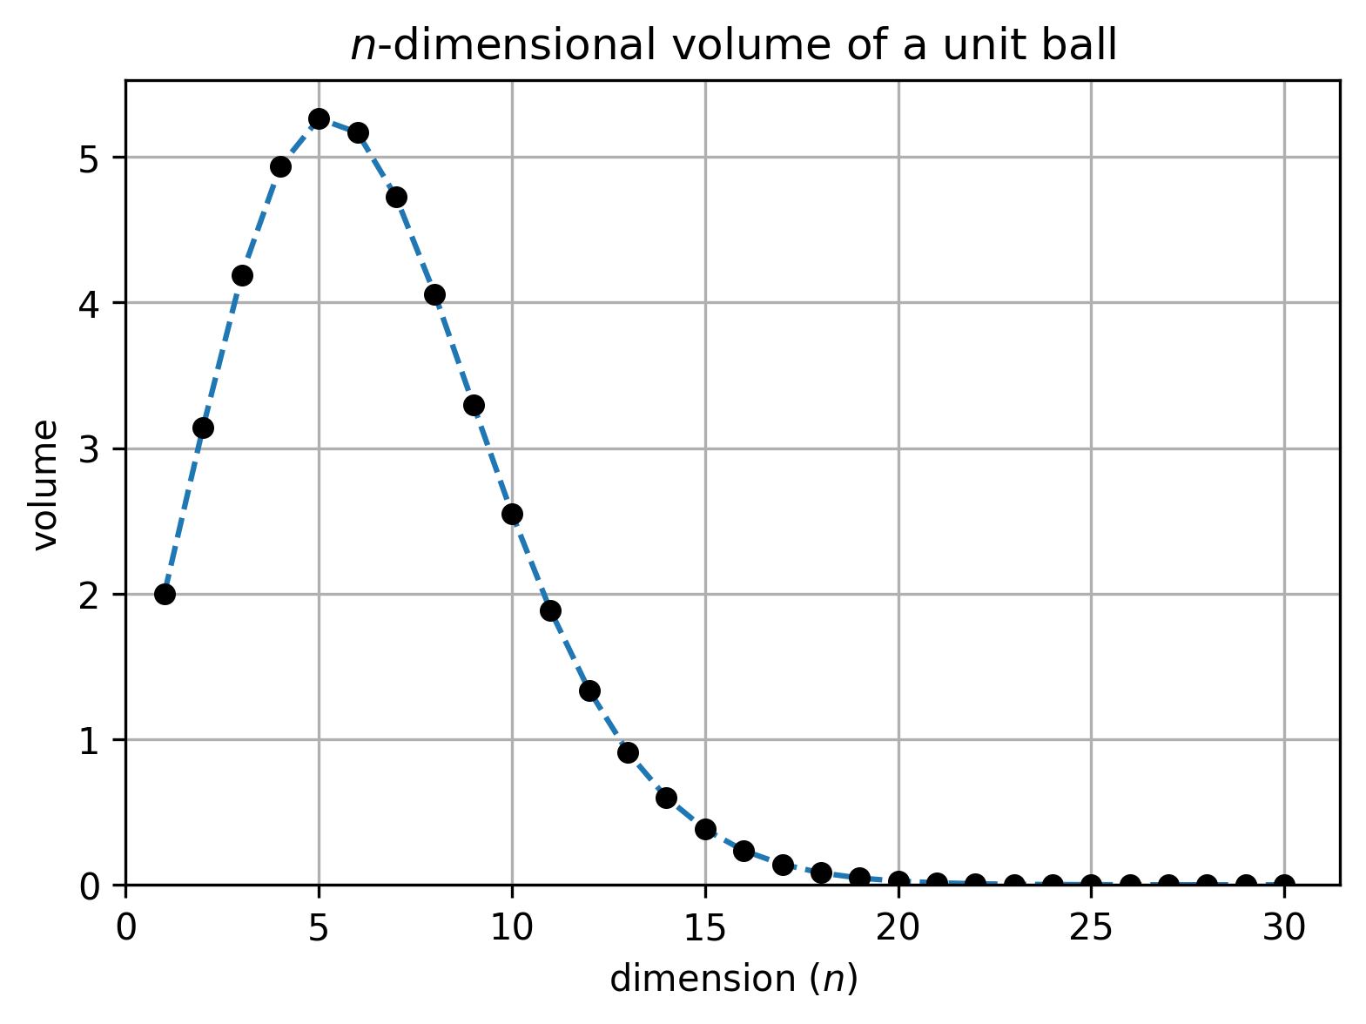
Higher dimensions of $π$
Notes:
Did you expect that?
=> “intuitional induction” from low dimensions are sometimes wrong
=> in high dimensions, unit balls are almost points (no volume) /!\ testing models with unit balls can be almost equivalent to testing with points

Slide 14
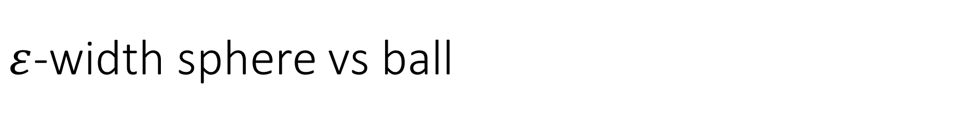
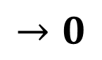
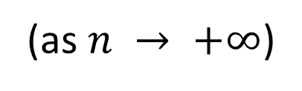
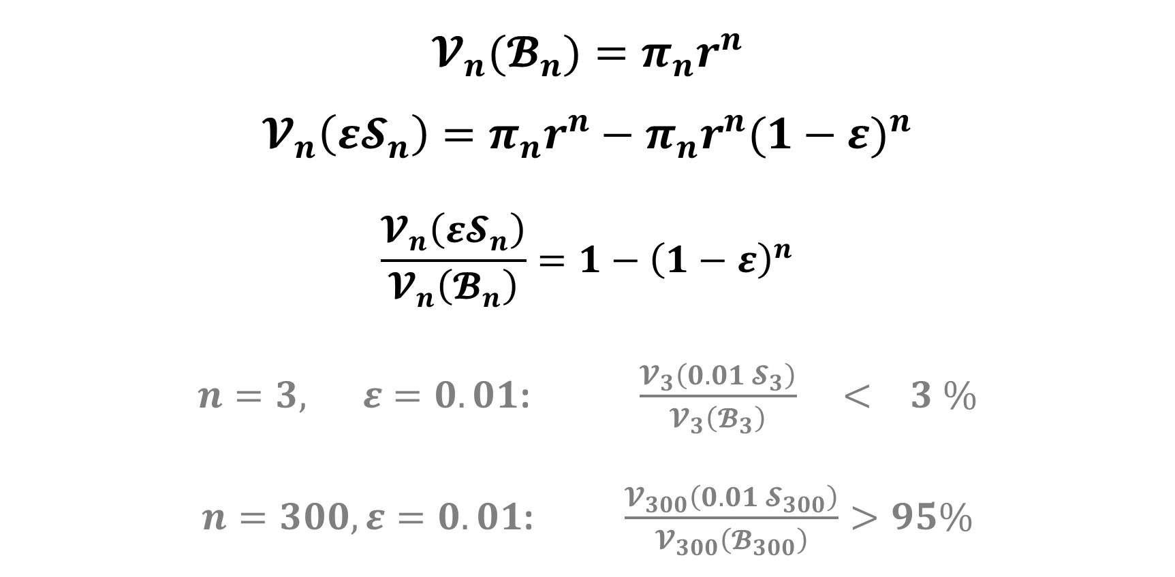
$ε$-width sphere vs ball
$$𝓥_{n}(𝓑_{n})=π_{n}r^{n}$$
$$𝓥_{n}\left({ε𝓢}_{n}\right)=π_{n}r^{n}−π_{n}r^{n}{(1−ε)}^{n}$$
$$\frac{𝓥_{n}\left({ε𝓢}_{n}\right)}{𝓥_{n}\left(𝓑_{n}\right)}=1−{\left(1−ε\right)}^{n}$$
$n=3, ε=0.01$: $\frac{𝓥_{3}\left(0.01 𝓢_{3}\right)}{𝓥_{3}\left(𝓑_{3}\right)} < 3 \%$
$n=300, ε=0.01$: $\frac{𝓥_{300}\left(0.01 𝓢_{300}\right)}{𝓥_{300}\left(𝓑_{300}\right)}>95\%$
$$→0$$
(as $n → +∞$)
Notes:
In high dimension, almost all the volume of a ball in on the boundary => both for unit AND non-unit balls!
=> testing models on spheres or balls is very similar

Slide 15
4 circles paradox

Slide 16
4 circles paradox

Slide 17
4 circles paradox
(-2,2)
(2,2)
(-2,-2)
(2,-2)
Notes:
4x4 square, centered at origin

Slide 18

4 circles paradox
(-2,2)
(2,2)
$1$
(-1,1)
(1,1)
(-1,-1)
(1,-1)
(-2,-2)
(2,-2)
Notes:
Fit 4 non-intersecting unit circles

Slide 19
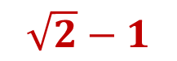
4 circles paradox
(-2,2)
(2,2)
$1$
(-1,1)
(1,1)
$\sqrt{2}−1$
(-1,-1)
(1,-1)
(-2,-2)
(2,-2)
Notes:
Make a circle centered at origin, the largest possible without intersecting the blue circles: its radius is $\sqrt{2}−1$

Slide 20
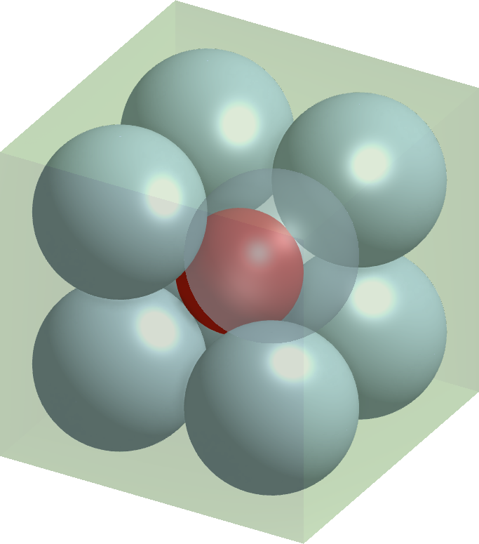
8 spheres paradox

Slide 21
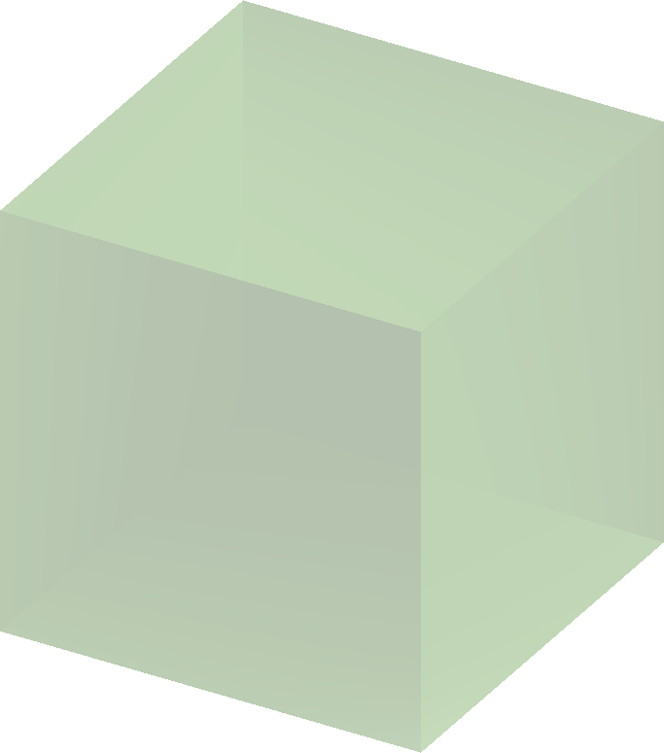
8 spheres paradox
4x4x4 cube
Notes:
4x4x4 cube, centered at origin

Slide 22
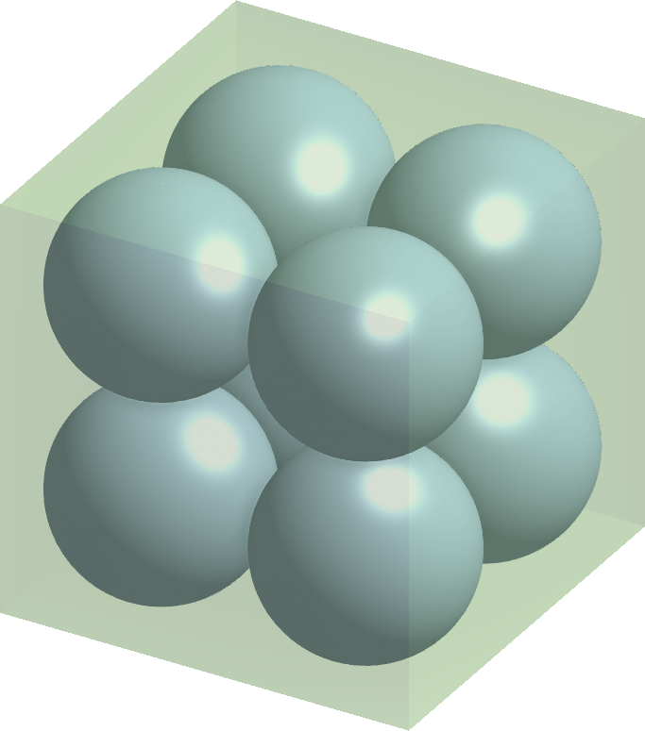
8 spheres paradox
4x4x4 cube
radius 1
Notes:
Fit 8 non-intersecting unit spheres

Slide 23
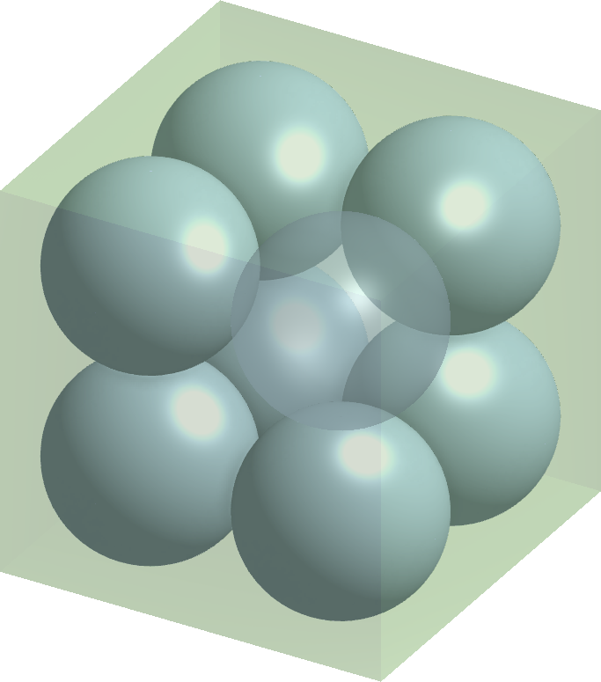
8 spheres paradox
4x4x4 cube
radius 1

Slide 24
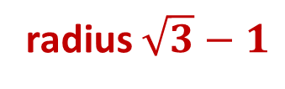
8 spheres paradox
4x4x4 cube
radius 1
radius $\sqrt{3}−1$
Notes:
Make a sphere centered at origin, the largest possible without intersecting the blue spheres: its radius is $\sqrt{3}−1$

Slide 25
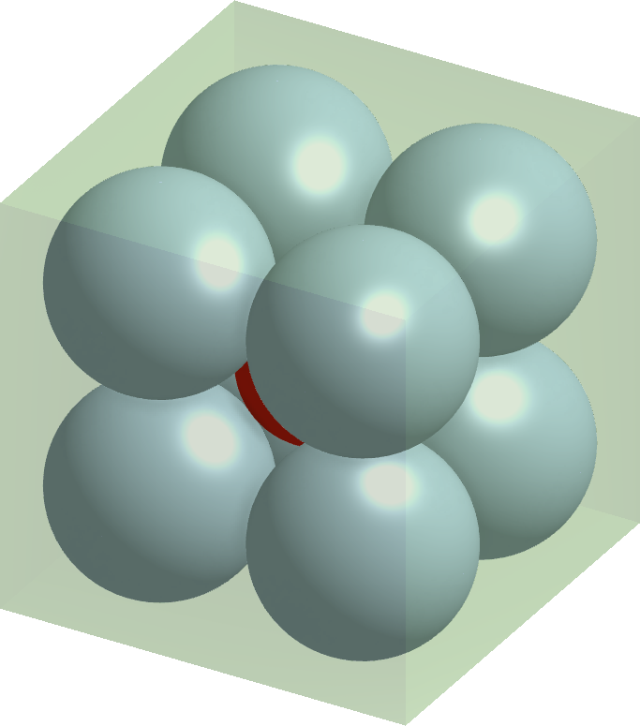
8 spheres paradox
4x4x4 cube
radius 1
radius $\sqrt{3}−1$

Slide 26
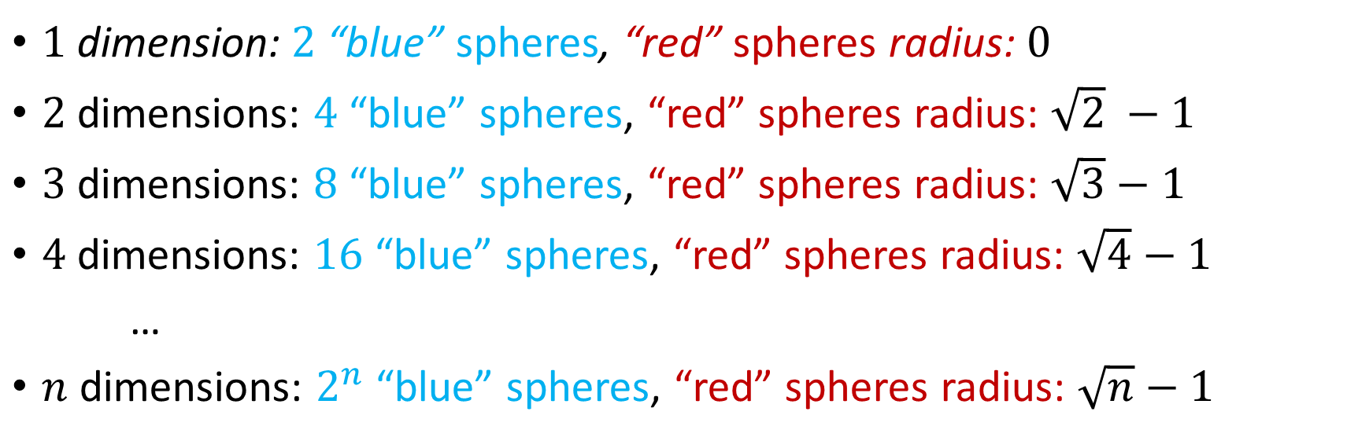
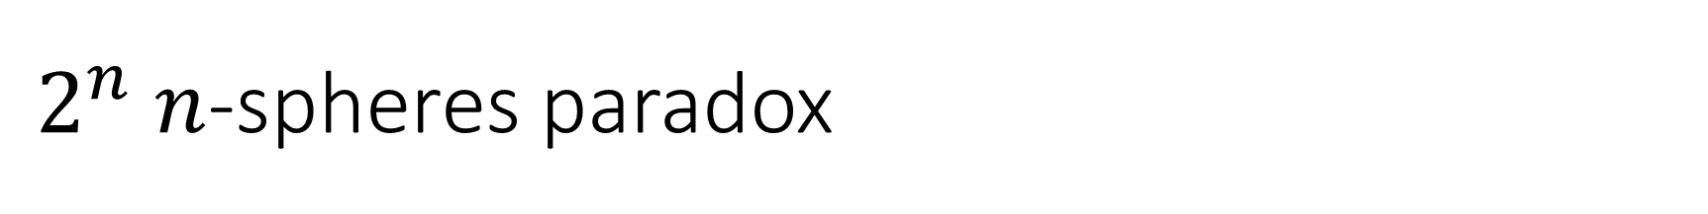
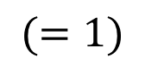
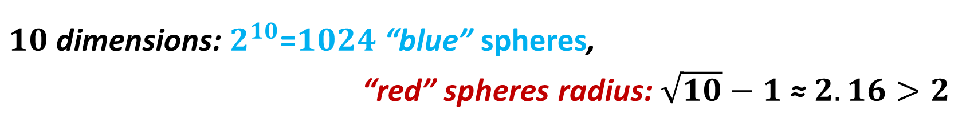
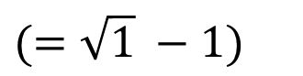
$2^{n}$ $n$-spheres paradox
$$(=\sqrt{1} −1)$$
$1$ dimension: $2$ “blue” spheres, “red” spheres radius: $0$
$2$ dimensions: $4$ “blue” spheres, “red” spheres radius: $\sqrt{2} −1$
$3$ dimensions: $8$ “blue” spheres, “red” spheres radius: $\sqrt{3}−1$
$4$ dimensions: $16$ “blue” spheres, “red” spheres radius: $\sqrt{4}−1$
…
$n$ dimensions: $2^{n}$ “blue” spheres, “red” spheres radius: $\sqrt{n}−1$
$$(=1)$$
$10$ dimensions: $2^{10}$=$1024$ “blue” spheres,
“red” spheres radius: $\sqrt{10}−1$ ≈ $2.16>2$

Slide 27
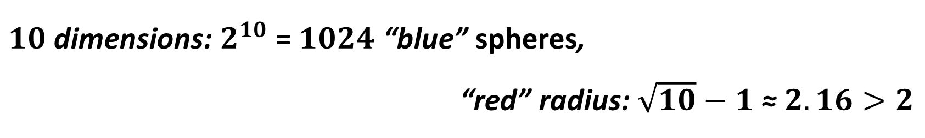
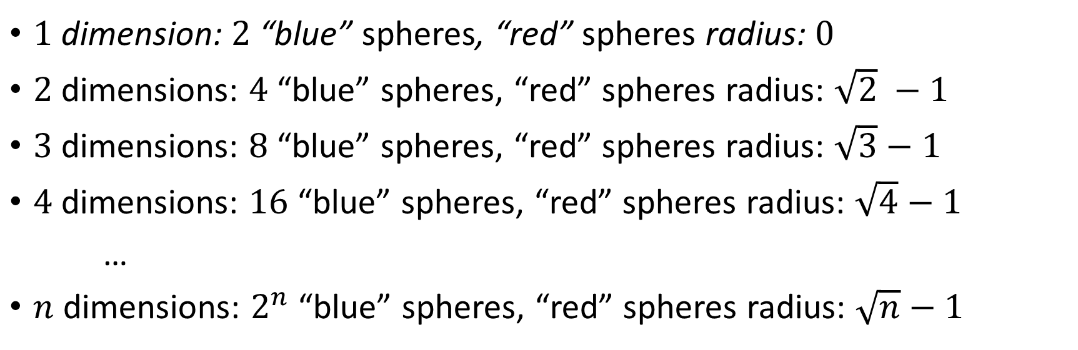
$2^{n}$ $n$-spheres paradox
$$(=\sqrt{1} −1)$$
$1$ dimension: $2$ “blue” spheres, “red” spheres radius: $0$
$2$ dimensions: $4$ “blue” spheres, “red” spheres radius: $\sqrt{2} −1$
$3$ dimensions: $8$ “blue” spheres, “red” spheres radius: $\sqrt{3}−1$
$4$ dimensions: $16$ “blue” spheres, “red” spheres radius: $\sqrt{4}−1$
…
$n$ dimensions: $2^{n}$ “blue” spheres, “red” spheres radius: $\sqrt{n}−1$
$$(=1)$$
$10$ dimensions: $2^{10}$ = $1024$ “blue” spheres,
“red” radius: $\sqrt{10}−1$ ≈ $2.16>2$
Notes:
N dim: make sure everyone agree with that formula
Then show the 10 dim
Actually, even 4 dim is a little weird

Slide 28
4 circles paradox

Slide 29
4 circles paradox
Not Touching
Notes:
This is wrong: the blue sphere still touch each other in high dimensions

Slide 30
4 circles paradox
Not Touching
Notes:
This is wrong: the blue sphere still touch each other in high dimensions

Slide 31

8 spheres paradox

Slide 32
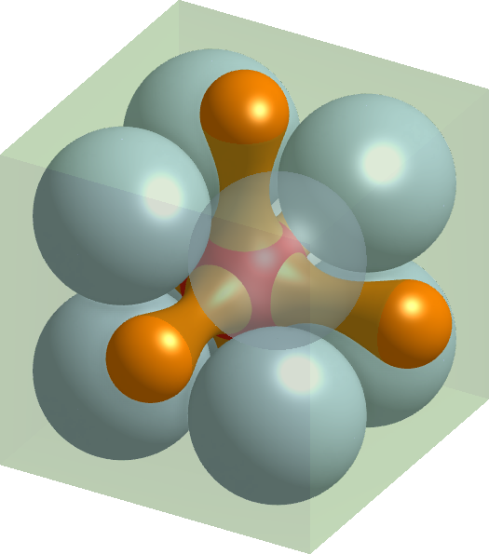
8 spheres paradox
Not Convex
Notes:
This is wrong: the red sphere remains convex in high dimensions

Slide 33
8 spheres paradox
Not Convex
Notes:
This is wrong: the red sphere remains convex in high dimensions

Slide 34
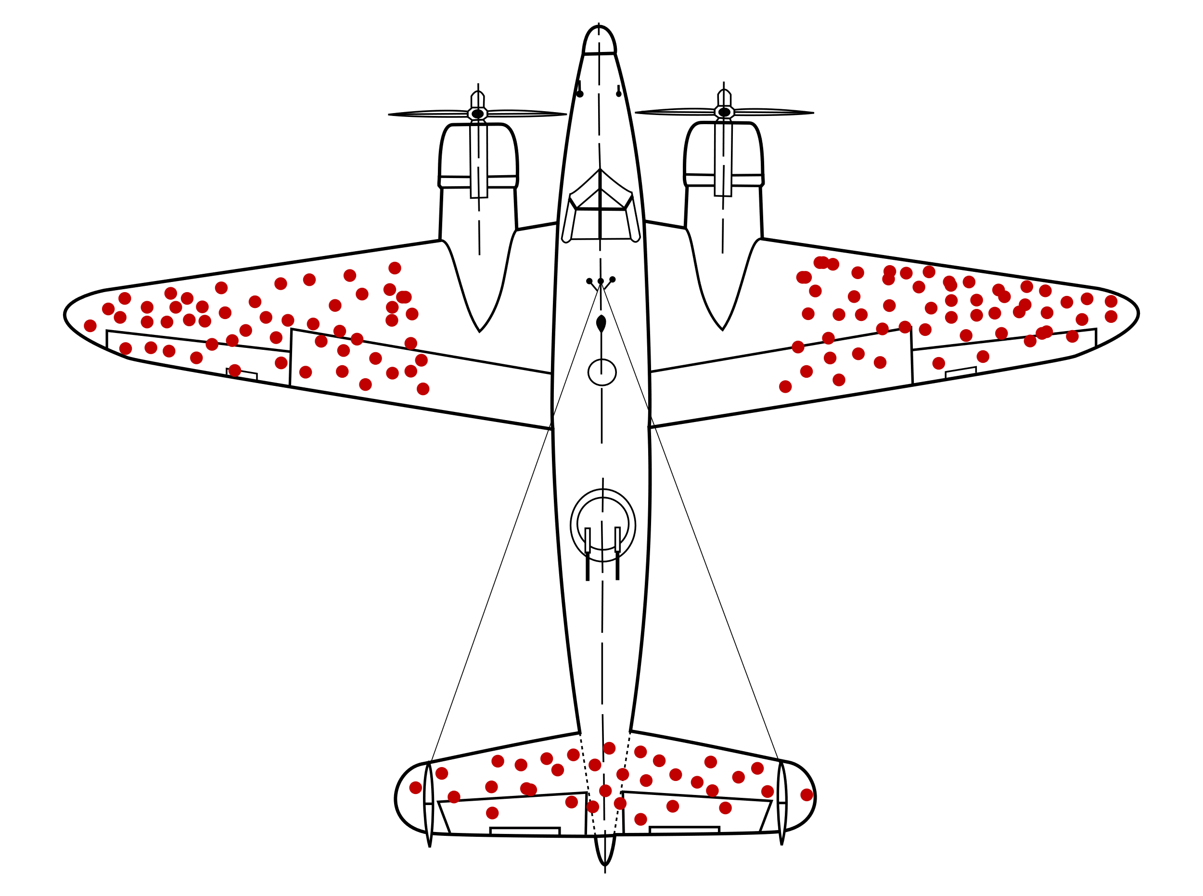
Statistics
Notes:
Royal Air Force story

Slide 35
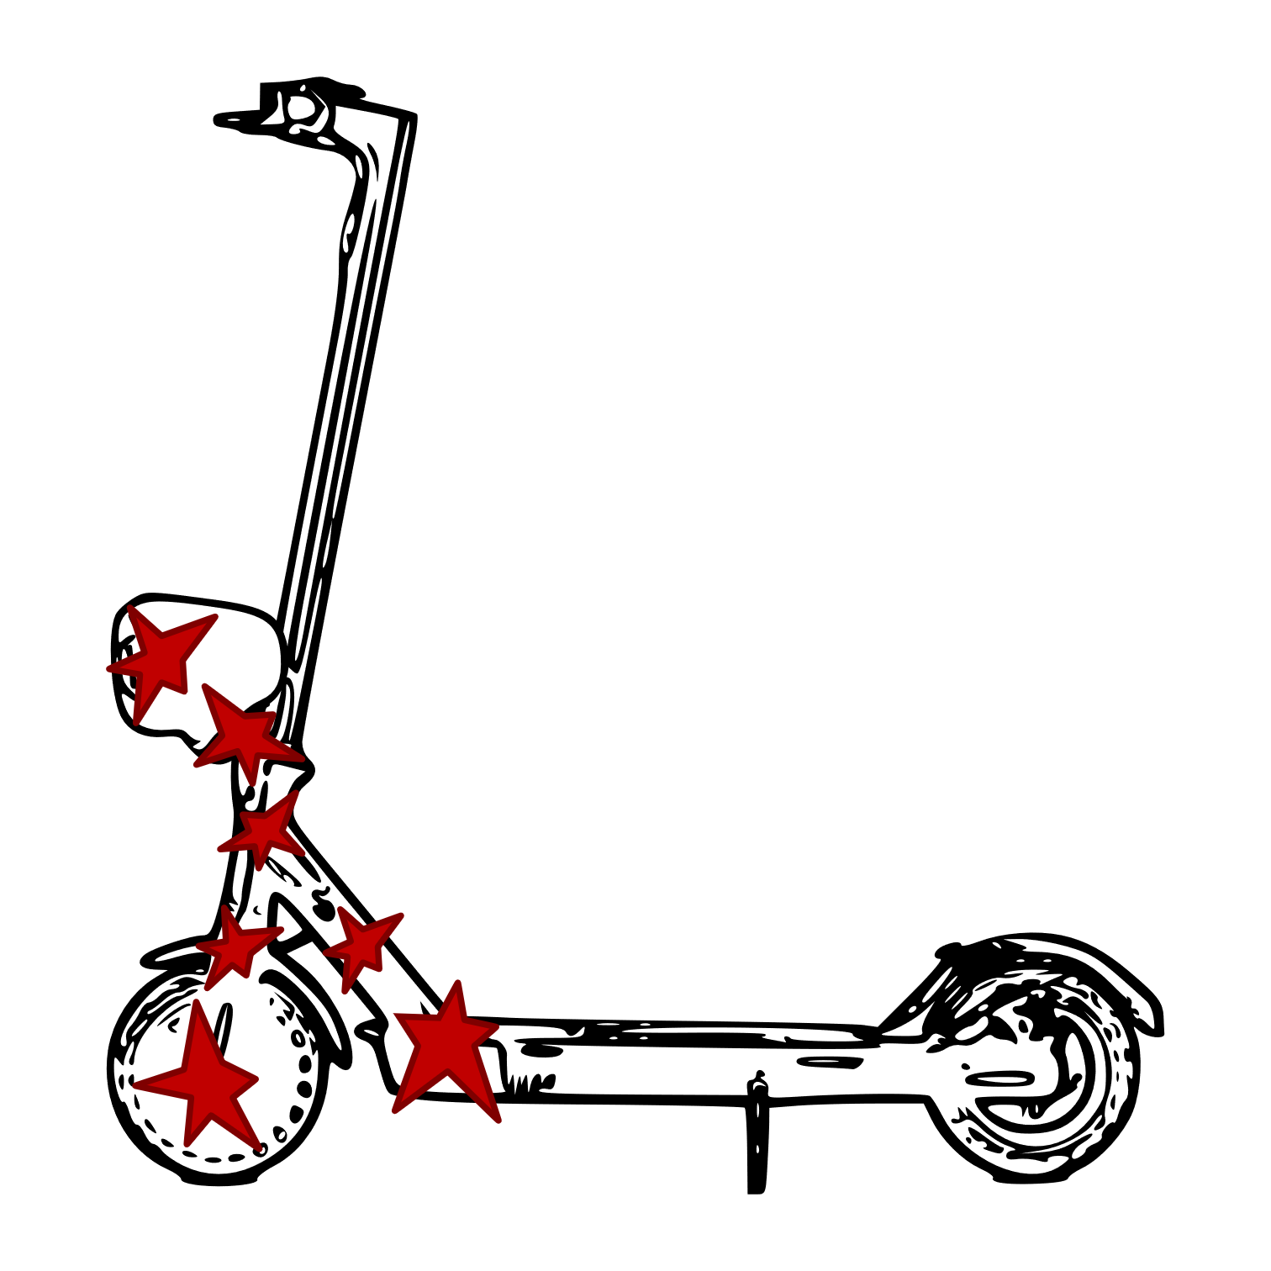
Over Interpretation
Notes:
Non-uniform damaging => cannot apply previous conclusion

Slide 36
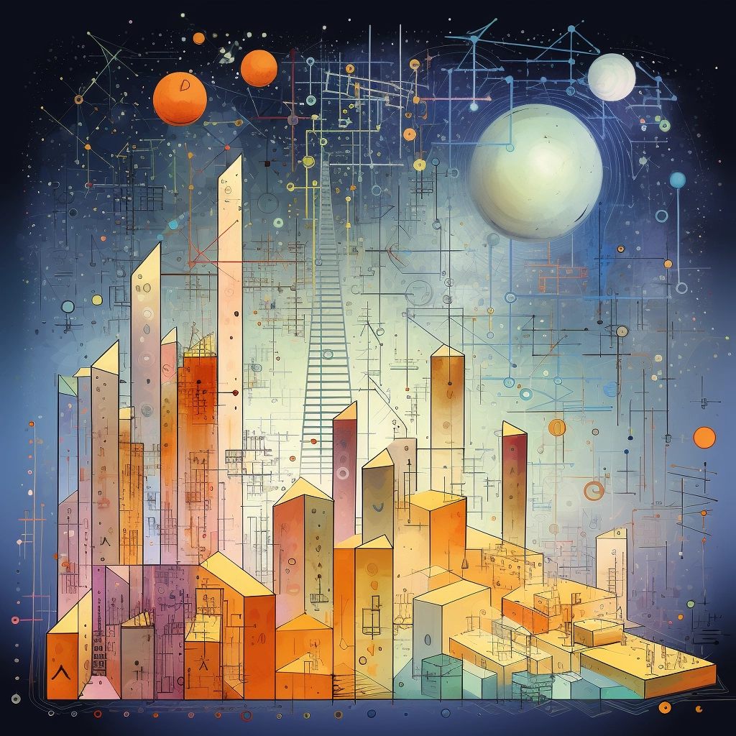



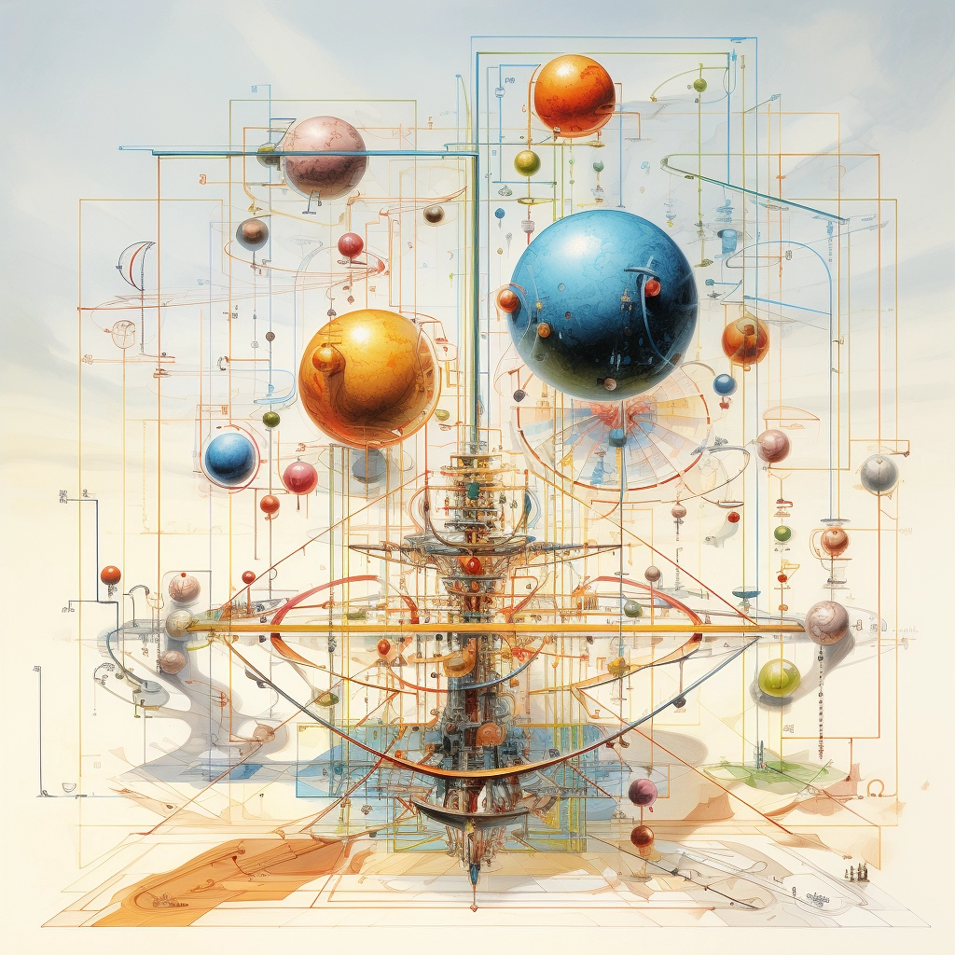
“high dimensions” (MidJourney)
Notes:
Final note: mid-journey’s illustration of “high dimensions”… is probably not useful… or is it?
Merry Christmas !

Slide 37
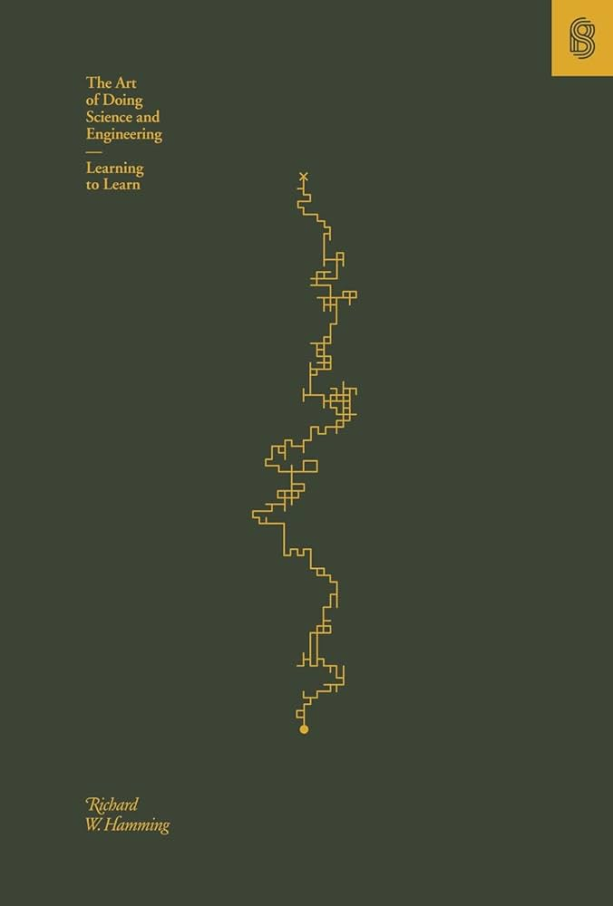

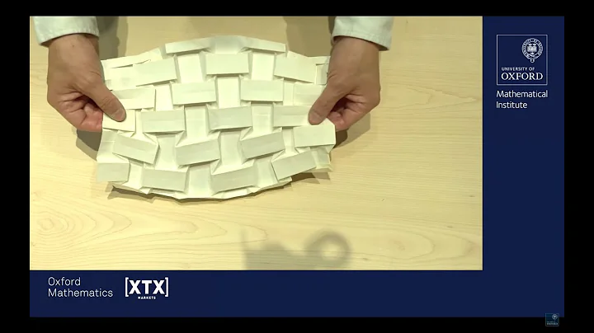
References
“The Art of Doing Science and Engineering” (Richard Hamming), Book, 1997
“A world from a sheet of paper” (Tadashi Tokieda), Oxford Mathematics Public Lecture, 14th of June 2023
“The Legend of Abraham Wald” (Bill Casselman), American Mathematical Society Public Outreach, June 2016
“MidJourney” V5.2 (Midjourney Inc.), https://www.midjourney.com/, 22nd of June 2023

